Slide 1
An Introduction to Working with Geospatial Data in R
By: Ayanthi Gunawardana

Slide 2
Overview of Tutorial
Powerpoint Topics
Basic geospatial concepts and files
Map Elements
NYC Open Data Overview
R-Markdown Demonstration
Importing geospatial data in to R sf dataframes
Processing R sf data
Presenting this data on a map for exploratory and presentation purposes using ggplot2 and tmap
Notes:
Note: we are only using vector data today. Explain what vector data is

Slide 3
What Makes Geospatial Data Different than Other Data?
Geospatial data contains geographic information that allows us to visualize it on a map
x/y coordinates
Derived from the projected coordinate system
Lat/long
Derived from the geographic coordinate system
Street address, city, state, zip code
Need a geocoder to use address data
Computationally expensive and may require a subscription

Slide 4
Why Use R for Geospatial Analysis?
Enterprise GIS software is costly
Allows us to automate processes
Less “point and click”
there’s a trail of code to retrace your steps; better reproducibility
Interactive mapping capabilities
Useful for exploratory purposes and creating shiny apps

Slide 5
Global Coordinate System vs. Projected Coordinate System
Every geospatial data set is mapped to a coordinate system
Latitude/longitude
Measured in degrees; in relation to the entire globe
Cannot measure distance using a global coordinate system
A projected coordinate system allows you to measure distance between locations
Projections are specific to the region you’re mapping
Projections are inherently distorted because you are taking a round surface (the globe) and flattening it on to a map

Slide 6

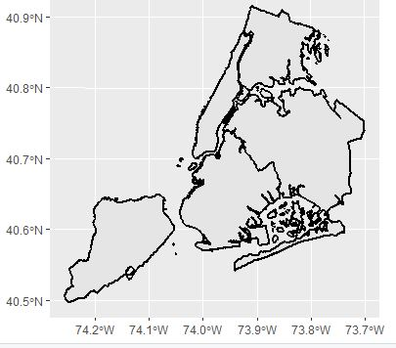
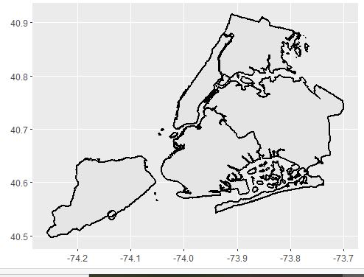
Data With Coordinate System Assigned
Data Without a Defined Coordinate System

Slide 7
File Formats of Geospatial Data
Excel/csv file
File needs to have x/y or lat/long columns
*Need to know GCS
Shapefile
Multi-part file that contains geographic data, made for GIS software
GeoJSON
Open source format
Geodatabase
Database that stores multiple shapefiles

Slide 8
Shapefile – Data Dictionary
Series of four files that contains spatial data, projection data, and the backend table with all the columns
Government agencies that create and maintain GIS shapefiles will include a data dictionary
Includes the metadata stored in the shapefile
Also includes the definition of the columns
This is read/viewed outside of R, as it’s normally a pdf or a formatted excel file

Slide 9
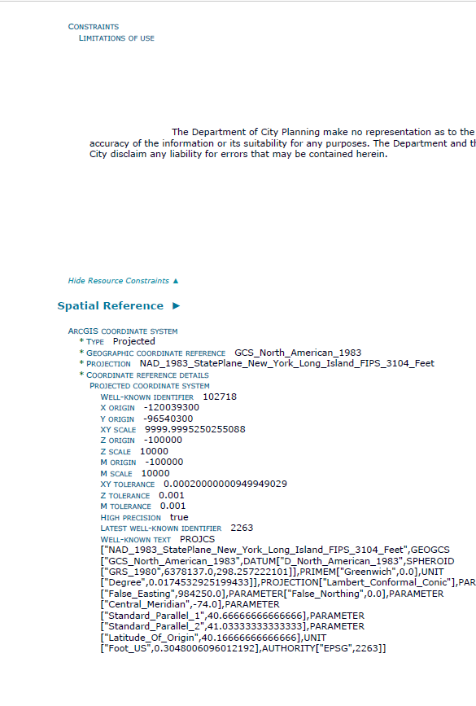
Sample Metadata
This is an example of the data dictionary for New York City’s LION file
LION is a representation of NYC’s street and boundary network
Note the details
Who created/maintains the data
Projection
Coordinate system

Slide 10
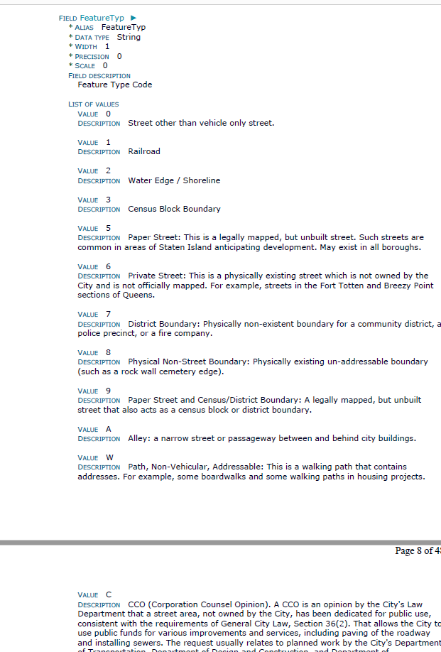
Detailed Information in Shapefile Data Dictionary
In addition to spatial information, those who maintain shapefiles will provide documentation of the columns and their definitions
This column FeatureTyp, is essential in determining what lines in the data are true streets, boundaries, railroads, or other lines that may not be associated with the street network

Slide 11
Where Can We Find GIS Data?
State and County Governments
Most states have a dedicated GIS resource
https://gis.ny.gov/
Municipal/City Governments
NYC is so large that we have local level GIS resources on NYC Open Data and the Department of City Planning
https://opendata.cityofnewyork.us/data/
https://www1.nyc.gov/site/planning/data-maps/open-data.page
Federal Governments
https://www.geoplatform.gov/
https://www.census.gov/geographies/mapping-files.html
Census GIS data can be linked to other census files using the geoid
Universities/Think Tanks/NGOs/Other

Slide 12
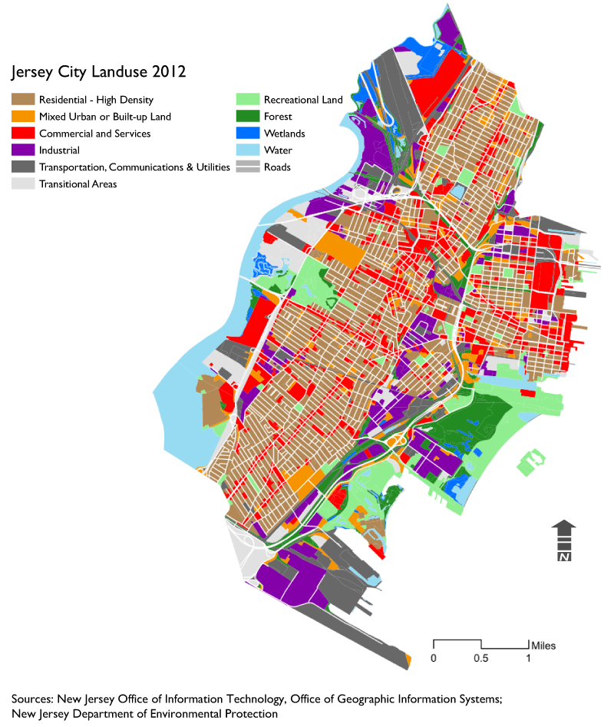
Map Elements
Title
Legend
Optional for simple maps; can be described in the title
Source
Especially important when using open data; the data is frequently updated so knowing the source and date retrieved is important
Scale Bar
North Arrow
Notes:
Describe what Jersey City, and what land use is.

Slide 13
Additional Geospatial Resources
Robin Lovelace’s online resource, “Geocomputation with R”
https://geocompr.robinlovelace.net/
Mapping with ggplot2
https://ggplot2-book.org/maps.html
Coordinate Systems and Projections
https://www.esri.com/arcgis-blog/products/arcgis-pro/mapping/coordinate-systems-difference/
GIS Crash Course Using R
https://bookdown.org/michael_bcalles/gis-crash-course-in-r/
Overview of different packages for displaying maps
https://rstudio-pubs-static.s3.amazonaws.com/324400_69a673183ba449e9af4011b1eeb456b9.html

Slide 14

NYC Open Data

Slide 15
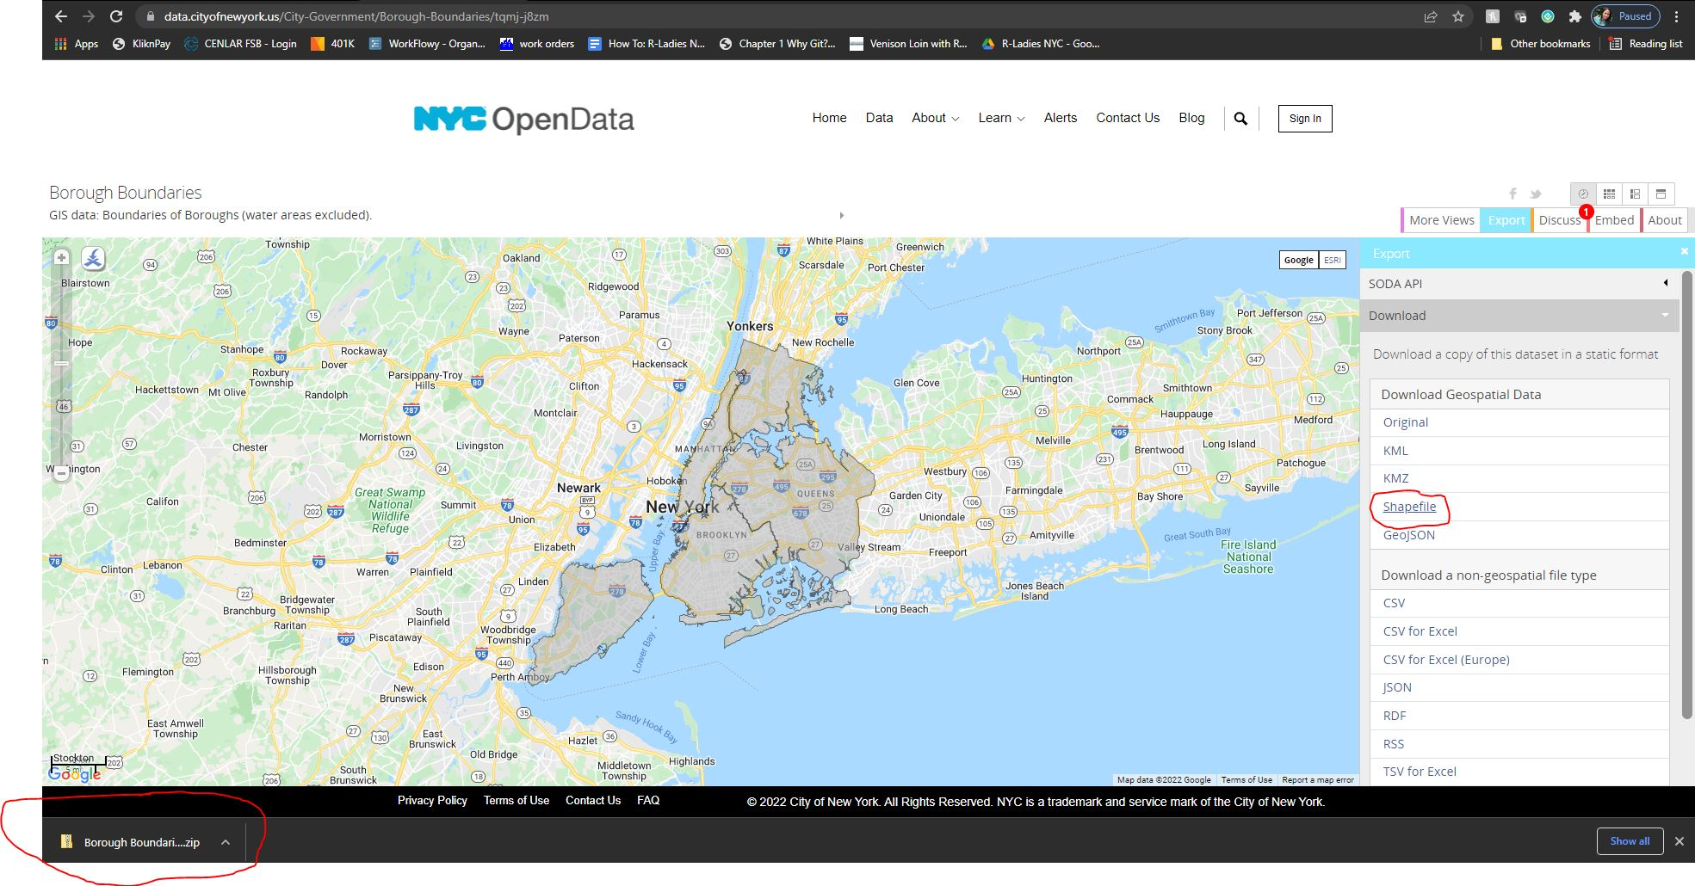

Slide 16
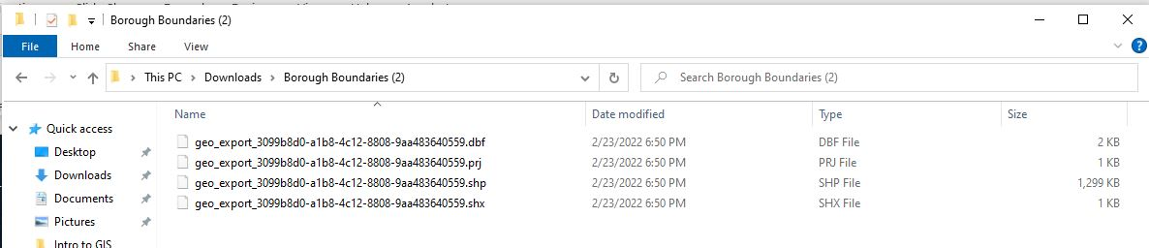
Note the Unclear File Name

Slide 17
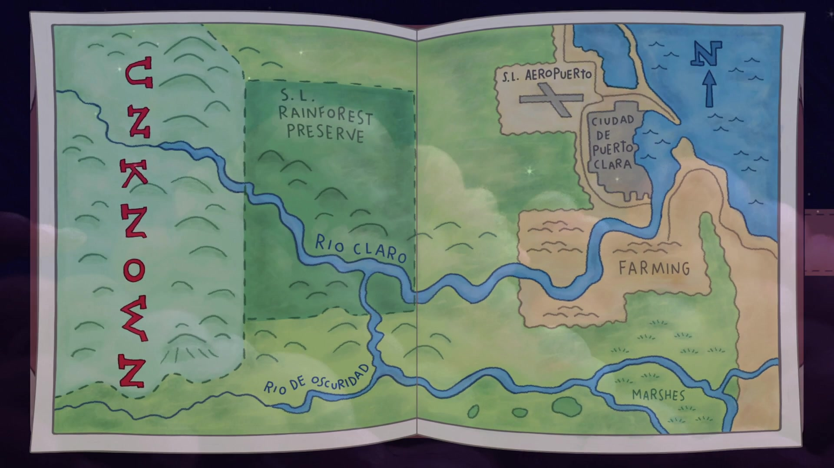
On to the R Markdown and Instruction!
Instead of manually pointing, clicking, downloading, unzipping, and renaming the data, we are going to do all those tasks in R!
Then we will process the data to make sure it becomes spatial and maps correctly
Finally, we will plot these points on various maps

